Slide 1

QuickBazaar An Online Marketplace
Group Members:
Name: Rafidul Islam ID: 1912152642
Name: Md Rafin Al Zhehad ID:1911626642
Name: Md. Riyad-Ur-Rahman ID:1911125642
01

Slide 2
Project Goal
To establish a user-friendly e-commerce platform that the customers will primarily find acceptable.
To full-fill all the requirements that needed to finish this
project.
In our project, we want to keep variety of products. Most notably, Bangladesh lacks an online marketplace for the sale of agricultural goods. These products will be highlighted on our website.
Better overall website design and layout.
We have planned to finish the web application first in 499A. Then, we will extend this project to Mobile Application in 499B.

Slide 3
Outcomes and Commitments
This project’s main objective would be boosting the efficiency of services, providing users with product information, reviews etc.
Making responsive e-commerce web application.
Users can search for a product, check the product’s review, add a product to cart, update the cart, rate a product. The web application will contain pagination system for user’s convenience. They can get emergency deliveries as well.
Admin can manage the whole web application. They have access to and control over every product from the admin area. The order details and delivery status can both be managed by the admin. They can also print the order information.

Slide 4
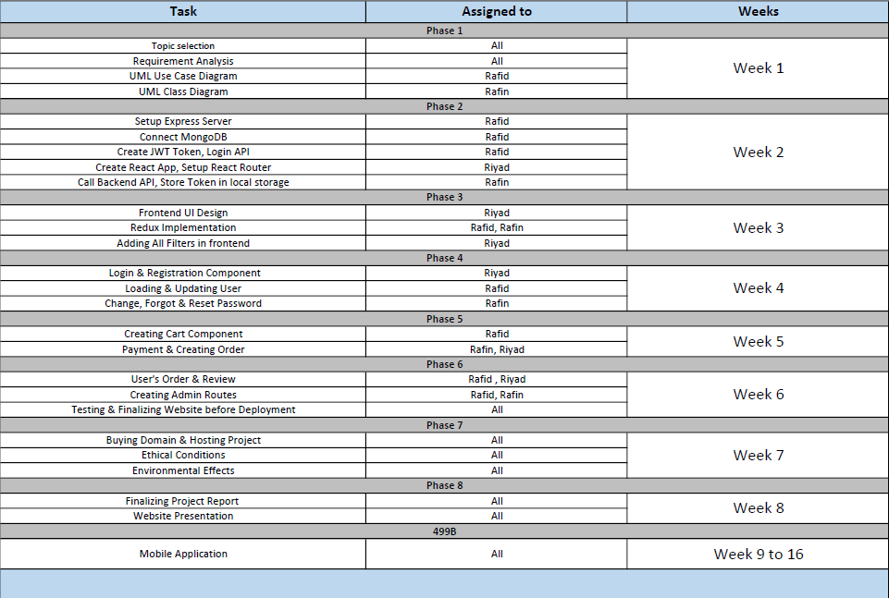
Outcomes and Commitments (Tasks & Activities)

Slide 5
Challenges
1
2
3
Maintaining web application’s security.
Maintaining user’s privacy.
Maintaining the database after hosting.

Slide 6
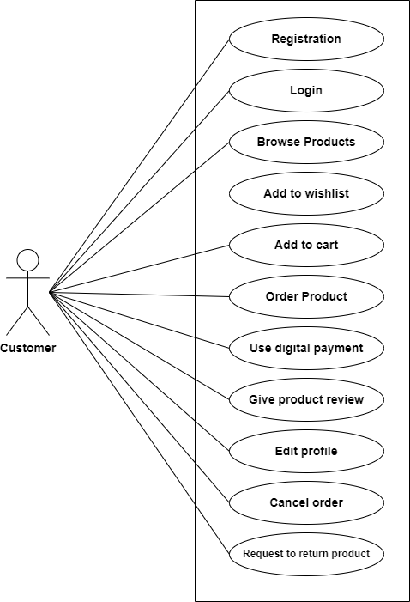
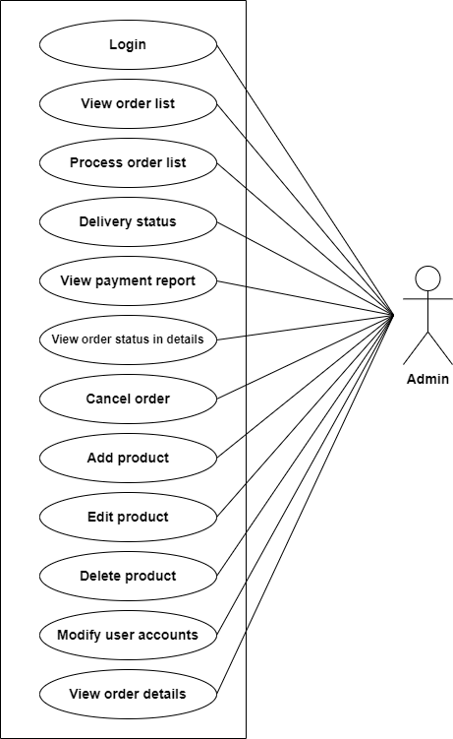

Visual Aids
UML Use Case Diagram

Slide 7
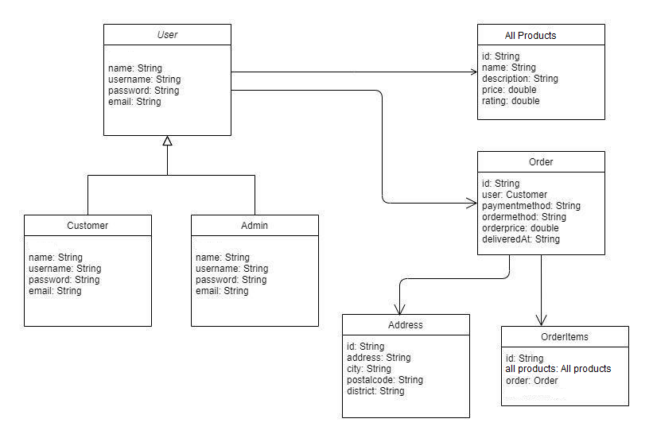
Visual Aids
UML Class Diagram

Slide 8
Estimated Budget
Service | Yearly Cost
Domain | $15
Hosting | $15
Total Cost | $30

Slide 9
Monitoring and approval
Each and every component of our project will continue to be evaluated. To ensure that every function operates as intended, we will test the codes. For testing and debugging, we'll employ various procedures. We'll assess whether the intended outcomes, deliverables, and results are met.

Slide 10
Thank you! ☺

